Slide 1
Introduction to Responsive Design
Coding with Samyak

Slide 2
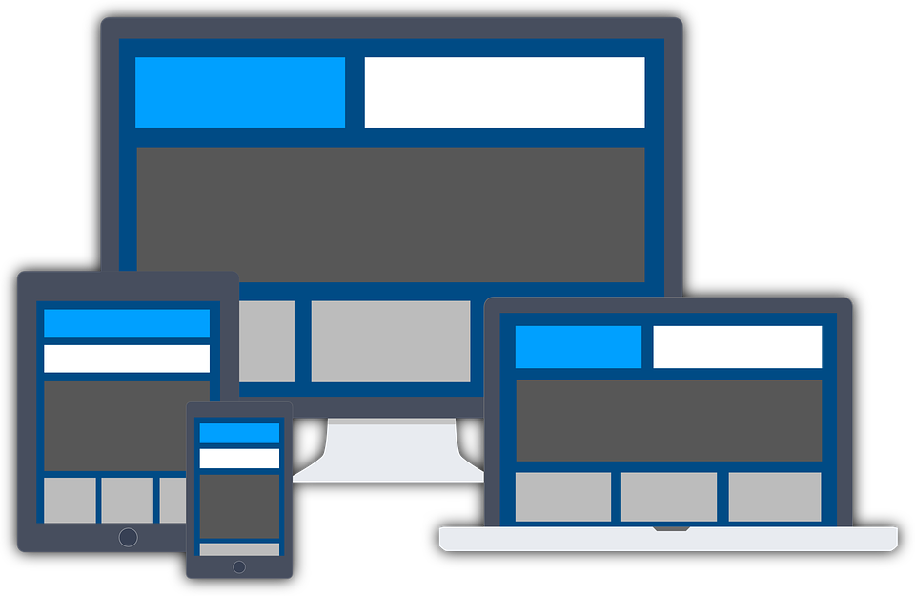
What is Responsive Design ?
Endless new resolutions and devices are difficult to support separately for a web developer.
Responsive design is a way for a web developer to make his website adapt to all the devices and resolution.
Responsive design is a necessity and not a luxury anymore!

Slide 3

Various ways to achieve responsive design
Setting up the viewport.
Use max-width/max-height.
Using CSS media queries.
Using rem/vh/vw units over pixels.

